Slide 1
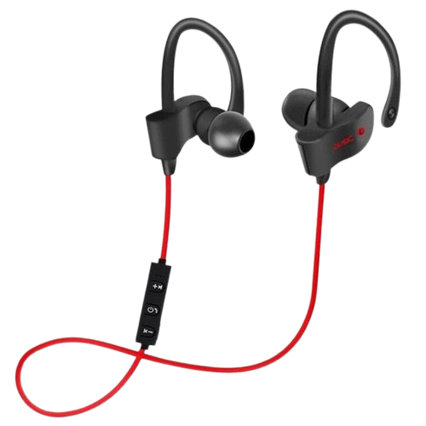
Enjoy
With
EARPHONE

Slide 2
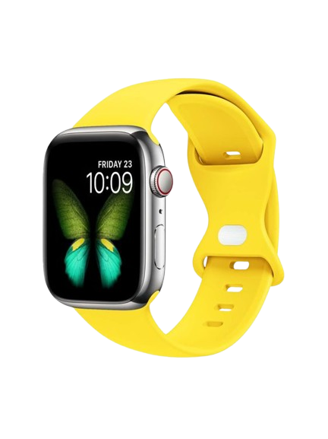
want
Wear
Watch

Slide 3
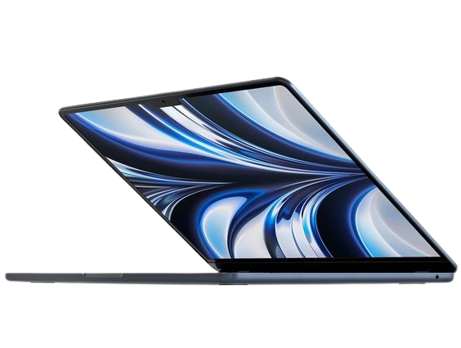
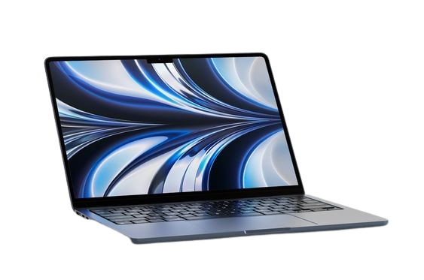
Tried
Devices
LAPTOP

Slide 4
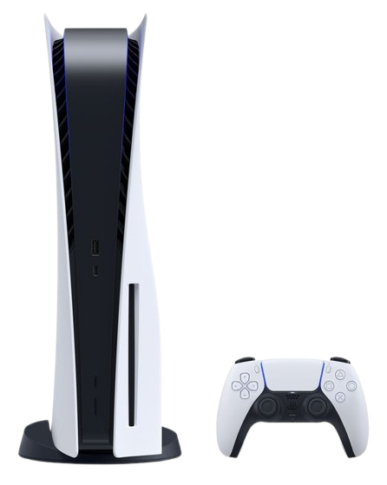
Console
Best
Gaming

Slide 5
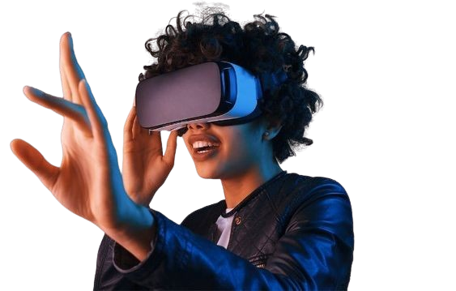
VR
play
Game

Slide 6
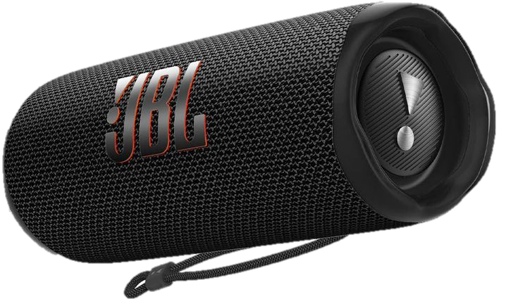
JBL
Now
SPEAKER

